Slide 1
Stock Price prediction
By Team Data Nerds

Slide 2
Team Data Nerds Mentor – Dr.John Basha M R Naveen Kumar – 19Btrcr005 A Rishab Vanigotha – 19BTRCR018 Sushil Bokade – 19BTRCR017 chethan s Pandit – 19btrcR002

Slide 3
Abstract
Predicting stock returns accurately is a very difficult task due to the volatile and non-linear nature of financial stock markets.
With the advent of artificial intelligence and increased computing power, programmed prediction methods have proven more effective in predicting stock prices.
This project aims to build a model using Recurrent Neural Networks (RNN) and especially Long-Short Term Memory model (LSTM) with technical analysis to predict future stock market values.

Slide 4
Introduction
MARKET
According to data from the National stock exchange (NSE), there are 1.2 crore active investors in India, a country of 138 crore people, as of August 2021.
value
The value of stock groups is computed with high market capitalization. There are different technical parameters to obtain statistical data from the value of stock prices.
Model
The stock values are generally dynamic, non-parametric, and non-linear; therefore, they often cause the weak performance of the statistical models and disability to predict the accurate values and movements.
To-do
This project is proposing a method for Stock Price Prediction and to identify trend of each stock with help of technical indicators.

Slide 5
Problem statement
Every day, the stock market makes headlines. Every time it reaches a new high or low, you hear about it.
If an efficient algorithm for predicting the short-term price of an individual stock could be developed, the rate of investment and business opportunities in the stock market could increase.
Previous stock prediction methods included the use of Artificial Neural Networks and Convolution Neural Networks, which have an average error loss of 20%.
In this report, we will investigate the feasibility of developing a model using Recurrent Neural Networks and Technical analysis to predict stock price with a lower percentage of error.

Slide 6
Methodology
There are various models available for predicting the price of stock market such as Supervised model and Deep learning models.
When a market is in up or down trend we can use supervised learning models like
Linear regression - It shows linear relationship between dependent and independent variables.
Decision trees – It forms a tree like structure to solve regression problem. Decision trees regression normally use mean squared error (MSE) to decide to split a node in two or more sub-nodes.
But most of the time market don’t be in a trend moreover it will be volatile or a ranging market.
Dataset - The dataset will be obtained from the NSEpy python library. NSEpy is a library that allows you to extract historical and real-time data from the NSE's website.
Model - LSTMs, or long-short-term memory networks, are a form of RNN that can learn long-term dependencies.
They are now widely used and perform admirably in a wide range of settings. Long-term reliance is a problem that LSTMs were developed specifically to alleviate.

Slide 7
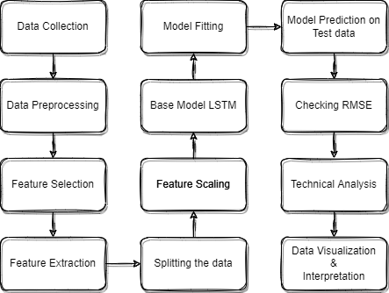
Work flow
Fig - 1

Slide 8
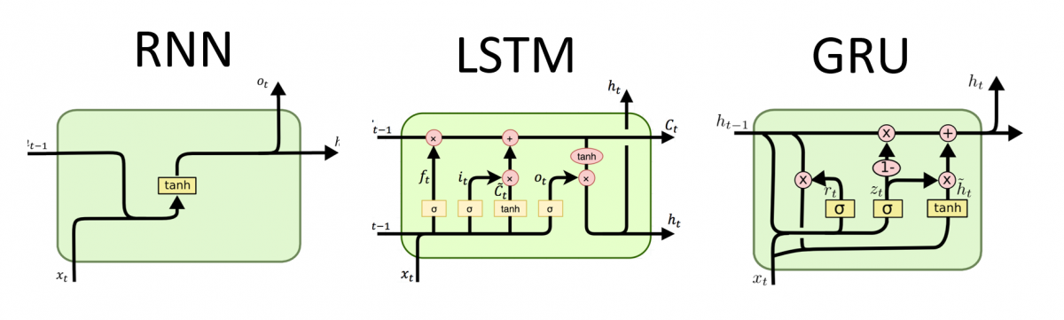
Why only LSTM?
RNNs have feedback loops in the recurrent layer. This lets them maintain information in ‘memory’ over time.
But, it can be difficult to train standard RNNs to solve problems that require learning long-term temporal dependencies.
This is because the gradient of the loss function decays exponentially with time (called the vanishing gradient problem).
LSTMs deal with vanishing and exploding gradient problem by introducing new gates, such as input and forget gates, which allow for a better control over the gradient flow and enable better preservation of “long-range dependencies”.
The long range dependency in RNN is resolved by increasing the number of repeating layer in LSTM.
Fig - 2
Fig - 3

Slide 9
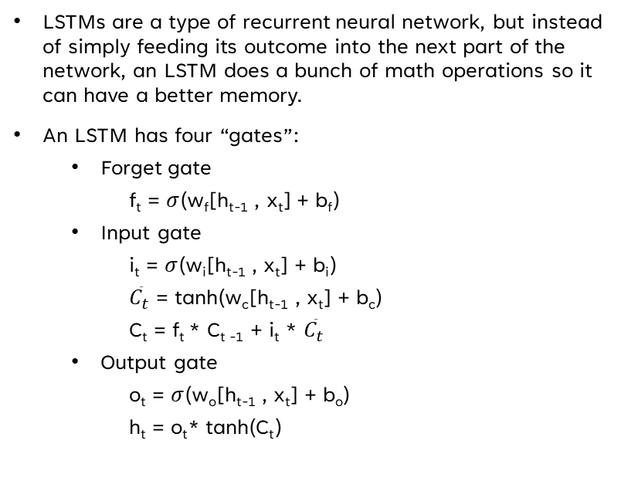
Working of lstm
LSTMs are a type of recurrent neural network, but instead of simply feeding its outcome into the next part of the network, an LSTM does a bunch of math operations so it can have a better memory.
An LSTM has four “gates”:
Forget gate
f_{t} = $σ$(w_{f}[h_{t-1} , x_{t}] + b_{f})
Input gate
i_{t} = $σ$(w_{i}[h_{t-1} , x_{t}] + b_{i})
${\overline{C}}_{t}$ = tanh(w_{c}[h_{t-1} , x_{t}] + b_{c})
C_{t} = f_{t} * C_{t -1} + i_{t} * ${\overline{C}}_{t}$
Output gate
o_{t} = $σ$(w_{o}[h_{t-1} , x_{t}] + b_{o})
h_{t} = o_{t}* tanh(C_{t})
Fig - 4

Slide 10
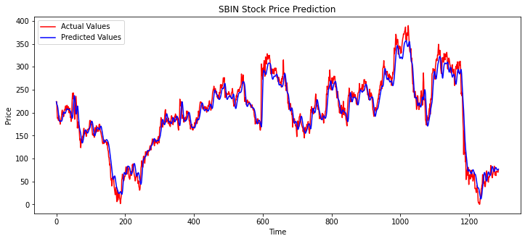
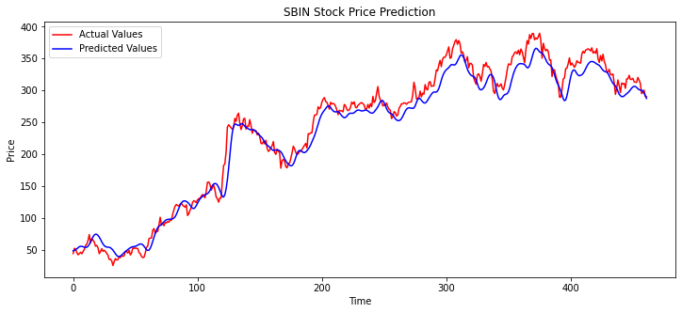
PREDICTIONS
Training data prediction
Testing data prediction
Fig - 5
Fig - 6

Slide 11
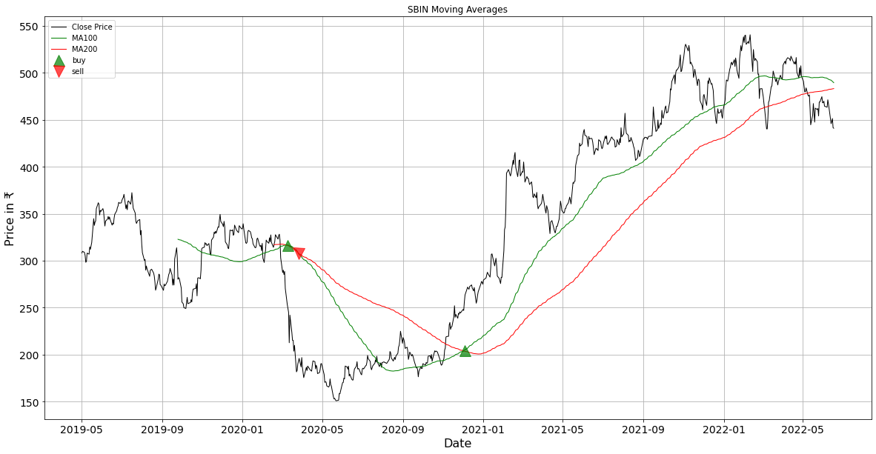
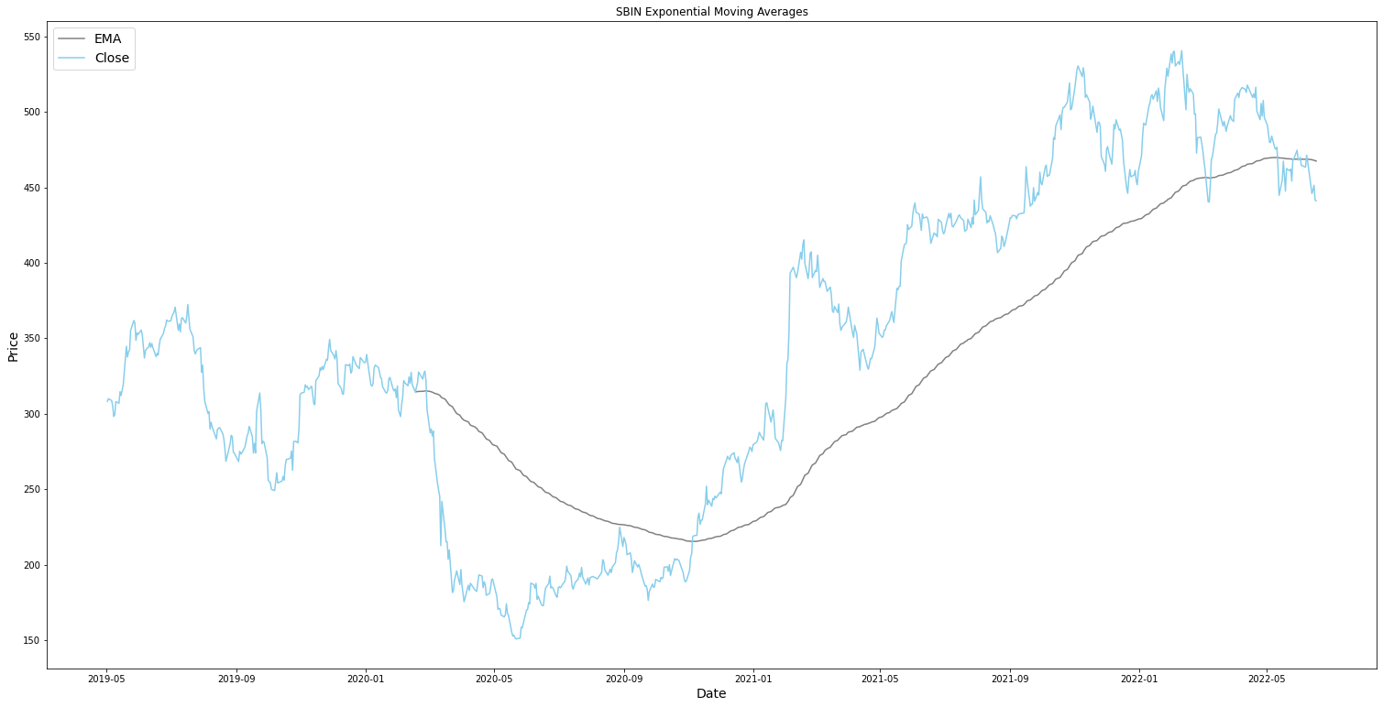
Technical Analysis
In addition to prediction, technical analysis is done. This aids in comprehensive stock analysis and advises users on whether to purchase, sell, or keep a certain stock.
Fig – 7 Moving Averages Crossover
Fig – 8 Exponential Moving Averages

Slide 12
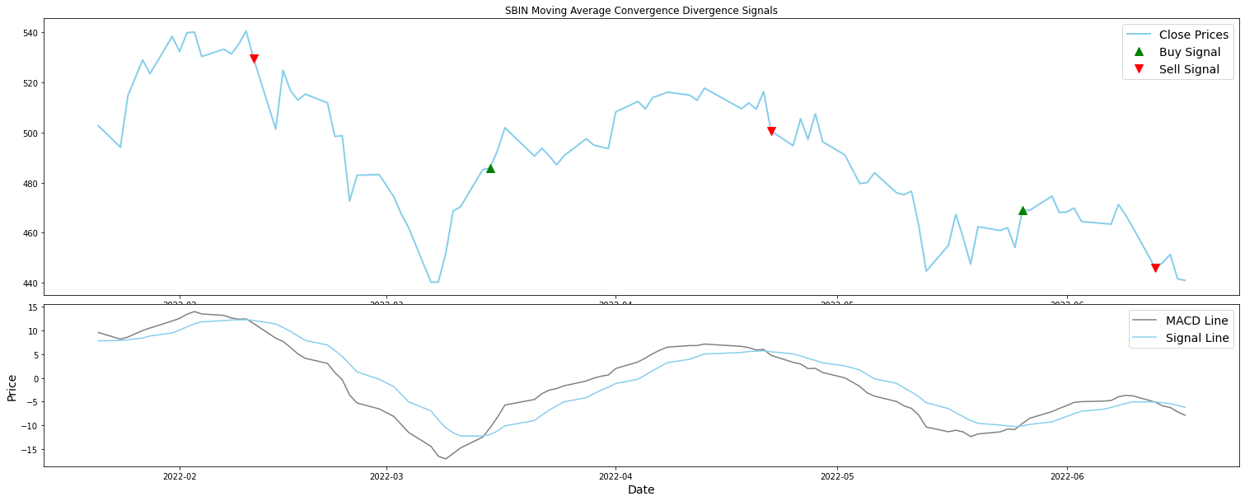
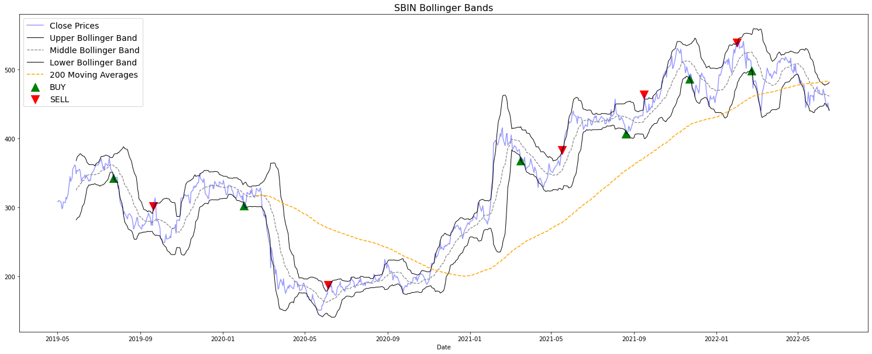
Fig – 8 MACD
Fig – 9 Bollinger Bands

Slide 13
results
When a model with many LSTM layers is run, say one with 128 units and a dropout of 0.2, another with 100 units and a dropout of 0.3, a third with 60 units and a dropout of 0.4, and a fourth with 60 units and a dropout of 0.5, To create an ideal stacked LSTM model, the model ran 50 epochs with 69 batches.
Training Error Metrics | SBI | JSW Steel
RMSE | 18.285 | 11.239
MAE | 13.586 | 8.0152
Testing Error Metrics | SBI | JSW Steel
RMSE | 17.252 | 40.021
MAE | 13.168 | 32.041
Table - 1
Table - 2

Slide 14
Pros and cons of lstm
Advantages
Disadvantages
No feature engineering
No character segmentation
Learns temporal relationships
Fast evaluation
LSTM are well-suited for Time Series data
Very slow training time (1-2 days)
Not very interpretable
Drop outs is much harder to implement in LSTM
It requires more memory to train
Easy to overfit

Slide 15
conclusion
A neural network system based on RNN i.e., LSTM will be created to provide a well-suited model for carrying out stock price prediction while obtaining a lower error rate thanks to the proposed technique, which makes sure that all prior restrictions have been acknowledged.
Any stock that has been listed in the NIFTY50 can use this model. Our algorithm has two steps:
The first predicts future prices using recent close prices, and
The second advises users on whether to BUY, SELL, or HOLD a certain stock using technical indicators such the RSI, MACD, MA, BB, and EMA. By analyzing a stock that an investor wants to buy, this model, which can be used online, will save investors time.

Slide 16
Refrences
[1] Y. Xia, Y. Liu and Z. Chen, ”Support Vector Regression for prediction of stock trend,” 2013 6th International Conference on Information Management, Innovation Management and Industrial Engineering, Xi’an, China, 2013, pp. 123-126, doi: 10.1109/ICIII.2013.6703098.
[2] Teja Kodali, ”Using kNN Classifier to Predict Whether the Price of Stock Will Increase”. [online]. Available: https://datascienceplus.com/knnclassifier-to-predict-price-of-stock/
[3] Sai Krishna Lakshminarayanan and John McCrae, ”A Comparative Study of SVM and LSTM Deep Learning Algorithms for Stock Market Prediction”. [online]. Available: http://ceur-ws.org/Vol-2563/aics41.pdf
[4] D. Karmiani, R. Kazi, A. Nambisan, A. Shah and V. Kamble, ”Comparison of Predictive Algorithms: Backpropagation, SVM, LSTM and Kalman Filter for Stock Market,” 2019 Amity International Conference on Artificial Intelligence (AICAI), Dubai, United Arab Emirates, 2019, pp. 228-234, doi: 10.1109/AICAI.2019.8701258.
[5] Raut Sushrut Deepak, Shinde Isha Uday, Dr. D. Malathi, “Machine Learning Approach In Stock Market Prediction”, IJPAM 2017
[6] M. S. Hegde, G. Krishna and R. Srinath, "An Ensemble Stock Predictor and Recommender System," 2018 International Conference on Advances in Computing, Communications and Informatics (ICACCI), Bangalore, 2018, pp. 1981-1985
[7] M. Roondiwala, H. Patel and S. Varma, "Predicting stock prices using LSTM," International Journal of Science and Research (IJSR), vol. 6, no. 4, pp. 1754-1756, 2017
https://towardsdatascience.com/making-a-trade-call-using-simple-moving-average-sma-crossover-strategy-python-implementation-29963326da7a
https://sentimentrader.com/blog/ultimate-guide-to-macd#:~:text=The%20optimal%20MACD%20setting%20was,ema%20of%20the%20MACD%20Line
https://medium.datadriveninvestor.com/3-simple-technical-indicators-for-long-term-investing-a100f02b9bed
https://blog.finology.in/investing/trend-analysis

Slide 17
Any queries?

Slide 18
THANK YOU

